Slide 1
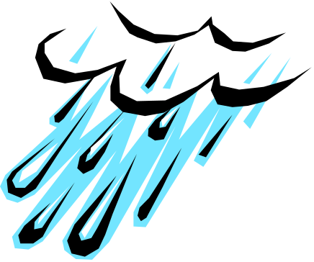

Cooperative Extension Service
Stormwater Training
Katie Teague
County Extension Agent- Agriculture/Water Quality

Slide 2
What is Extension?
Division of the Land-Grant Universities
  located in all 50 states & Puerto Rico
“Cooperative” effort
  Federal, State & county partnership
Outreach & Education
  provide informal public education
  relay research information

Slide 3


NWA Regional
Stormwater
Education Program
Since July 2004…
University of Arkansas Cooperative Extension Service
12 Cities
Benton and Washington Counties
U of A – Fayetteville Campus

Slide 4

By working together, the Benton and Washington County MS4s are:
  Educating each other about stormwater
  Reducing the financial cost for implementing mandated stormwater control measures
  Increasing the effectiveness of public education and participation programs
  Protecting water quality on a regional basis

Slide 5
Let's take a quiz…

Slide 6
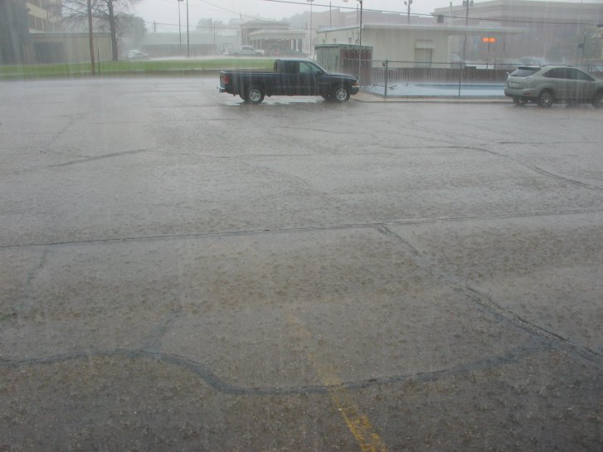
Stormwater Dynamics

Slide 7
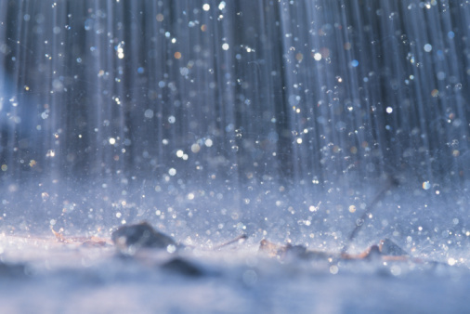
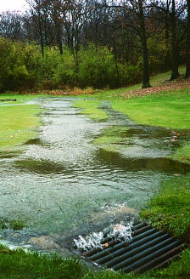
What is stormwater?
Runoff from natural precipitation, such
as rain events and snow melt and other
surface runoff and drainage

Slide 8
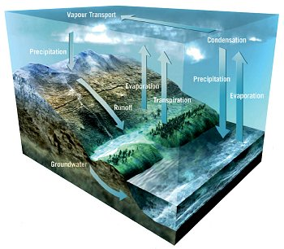

Slide 9
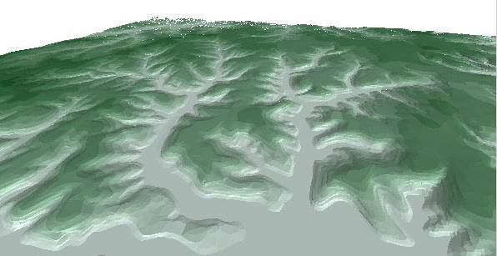
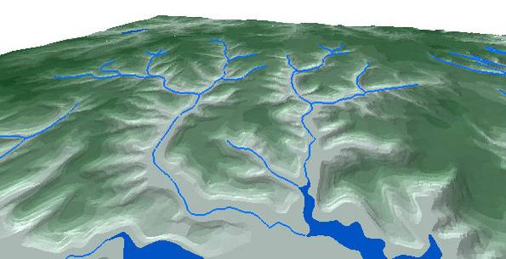

What Is a Watershed?
A watershed is the area of land that
all drains to a particular point
Center for Watershed Protection
Notes:
What is a Watershed? A watershed can be defined as the area of land that drains to a particular point along a stream. Each stream has its own watershed. Topography is the key element affecting this area of land. The boundary of a watershed is defined by the highest elevations surrounding the stream. A drop of water falling outside of the boundary will drain to another watershed.

Slide 10

Natural Ground Cover
40%
Evapotranspiration
10% Runoff
25%
Shallow
infiltration
25% Deep
infiltration
Source: U.S. EPA

Slide 11
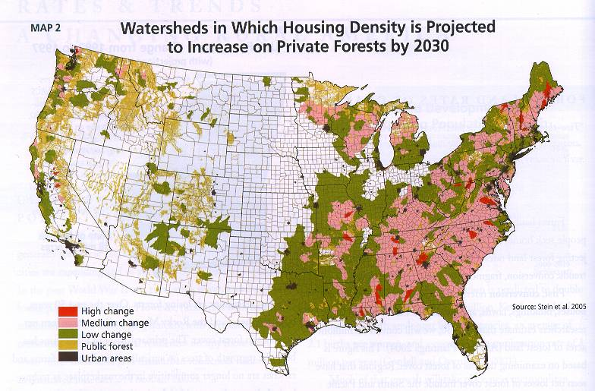

Slide 12
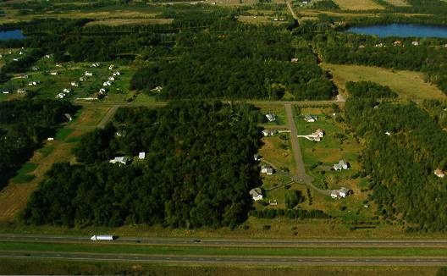
Source: USDA/NRCS

Slide 13
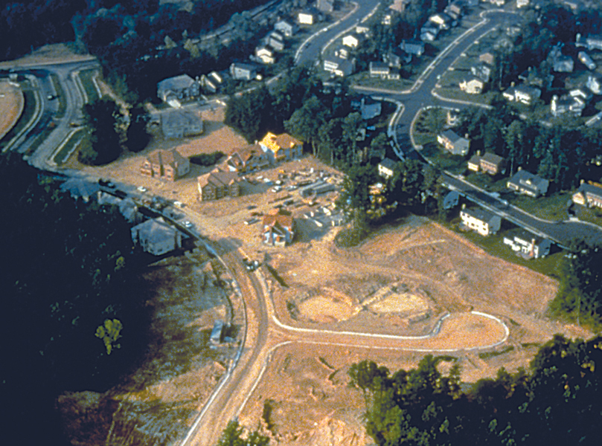
Source: U.S. EPA

Slide 14
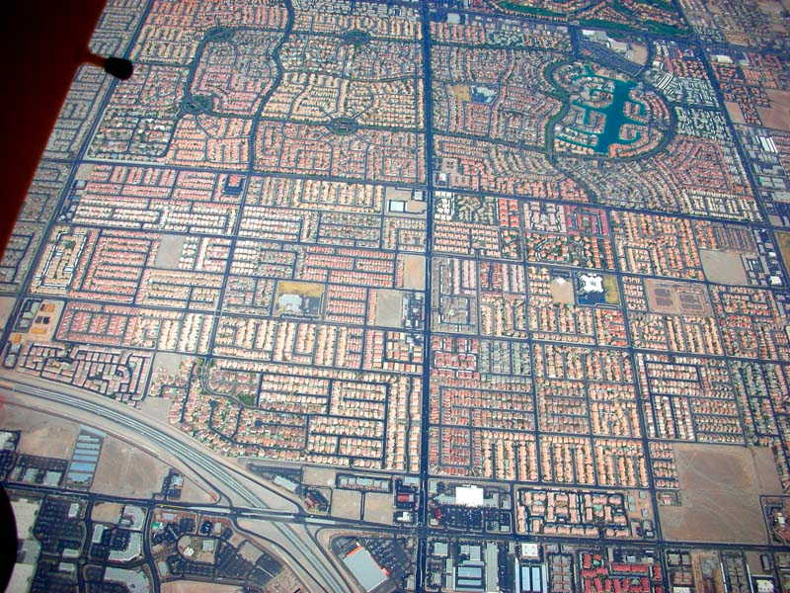

Slide 15
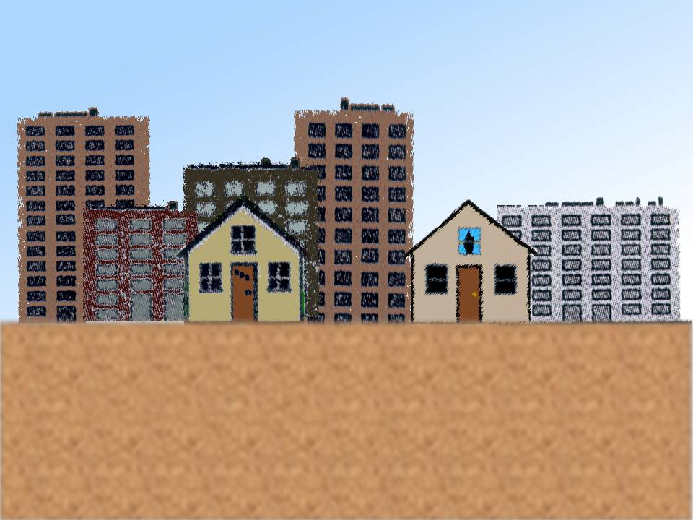
75 – 100%
Impervious surface
30%
Evapotranspiration
55% Runoff
5% Deep
infiltration
10%
Shallow infiltration
Source: U.S. EPA

Slide 16
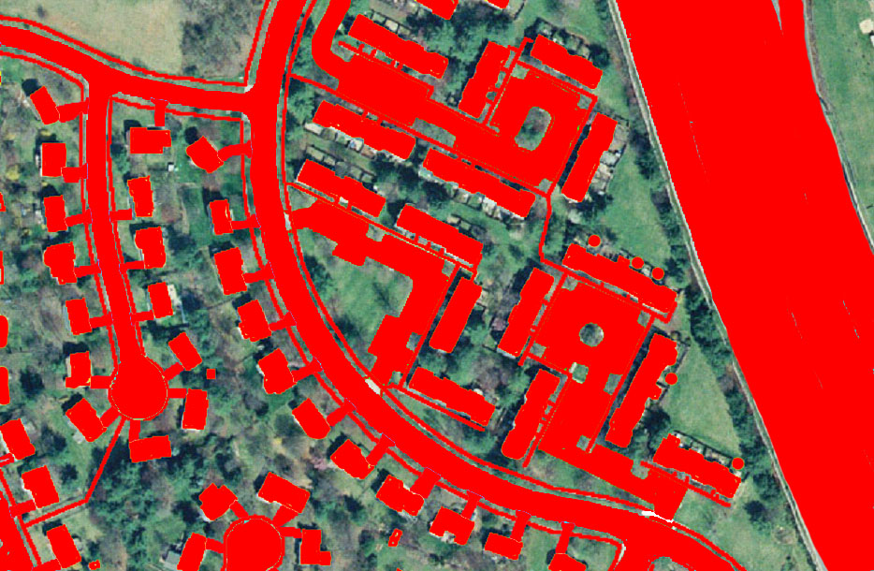
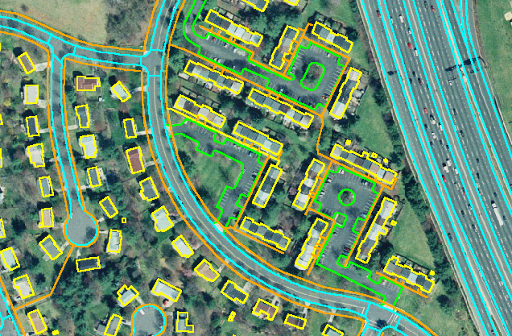
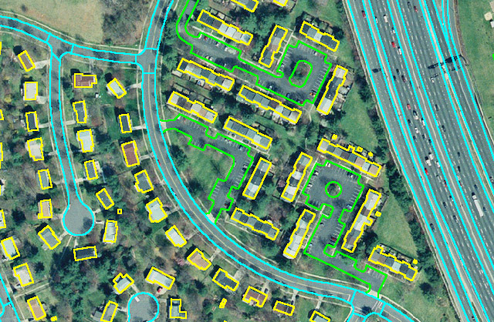
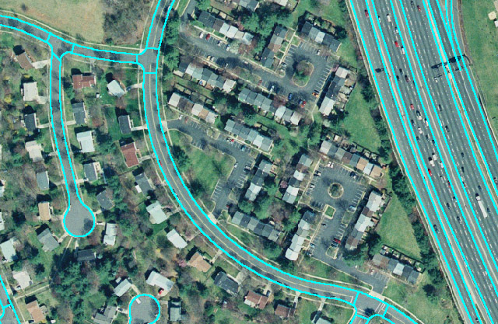
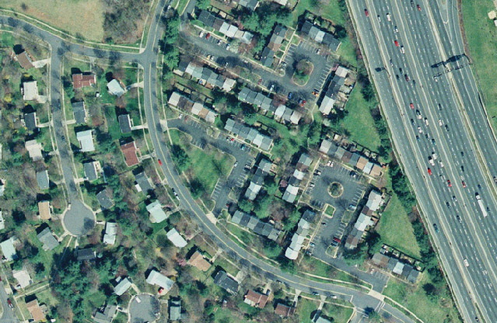
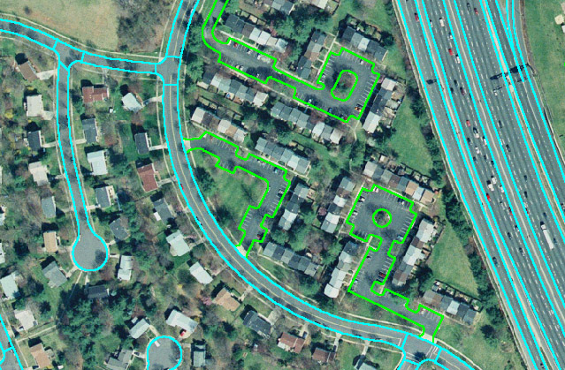
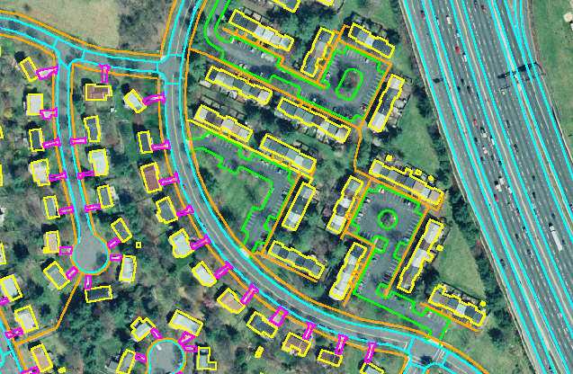
Many Forms of Impervious Cover in the Urban Landscape
Sidewalks
Roads
Parking
Driveways
Buildings
Center for Watershed Protection
Notes:
Development, such as a shopping center or a new house, produces impervious cover. Impervious cover is any surface in an urban watershed that does not allow water to soak into the ground. Forms of impervious cover include roads, parking lots, buildings, sidewalks, and driveways.

Slide 17
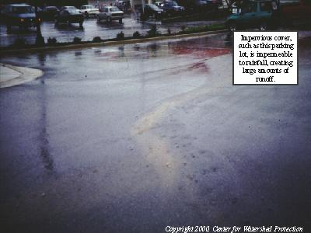
Impervious cover,
such as this parking,
lot, is impermeable
to rainfall, creating
runoff flowing into
storm drains.

Slide 18
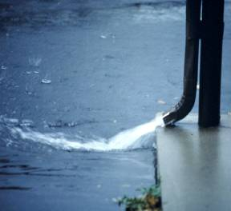
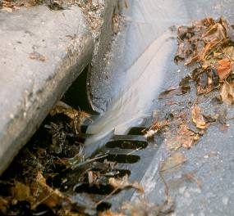
Impervious Cover Influences Wet Weather Stream Flow
When it rains, a large amount of water . . .
Runs off of impervious surfaces
Enters the stormdrain system
Is directed to nearby streams
Center for Watershed Protection
Notes:
Rain cannot soak into impervious surfaces, so during wet weather, large amounts of water is converted to runoff. Curbs, gutters, and storm drain pipes quickly move the runoff to the stream.

Slide 19
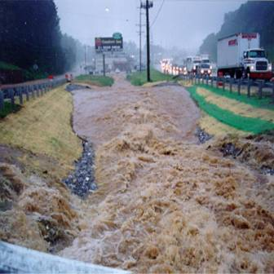
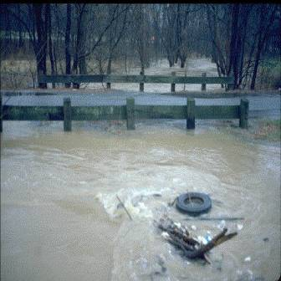
Impervious Cover Influences Wet Weather Stream Flow
The large amount of stormwater runoff in the stream system can cause:
More Frequent Flooding
Higher Flood Levels
Center for Watershed Protection
Notes:
Wet weather brings another extreme. The stormwater runoff created by the impervious cover is delivered to stream in high volumes and over a short period of time. As a result:
Flood events occur more often in urban streams
Urban streams have higher flood levels

Slide 20
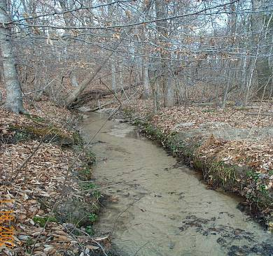
Impervious Cover Influences Stream Shape and Size
Large amounts of stormwater runoff due to impervious cover can:
Erode stream banks, making the banks steeper and the channel wider
Deposit soil on the stream bottom, making the stream more shallow
Cause straightening of the channel
Center for Watershed Protection
Notes:
Impervious cover can also influence stream size and shape. The high volume of water created by the increased stormwater runoff can:
Erode stream banks, making the banks steeper and the channel wider
Deposit soil on the stream bottom, making the stream more shallow
Cause straightening of the channel by the erosion and shifting of sediment. This change in channel shape causes water to be conveyed faster, which causes even greater erosion problems, and eliminates the slow-moving water that many species depend on for habitat.

Slide 21
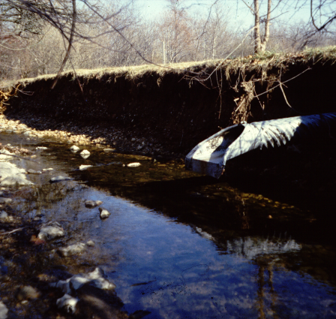
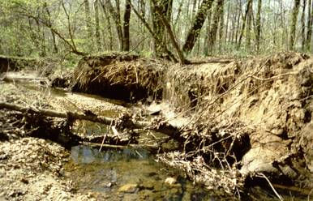
Stream Quality is Related to Impervious Cover
8-10%
20%
< 5%
Impervious Cover
30%
> 65%
Center for Watershed Protection
Notes:
This slide illustrates how stream quality, as measured by bank stability, water quality and available habitat, deteriorates when impervious cover increases in a watershed.
Watersheds with less then 5% impervious cover, have stable stream banks, good water quality and provide a variety of habitat.
The second picture shows a stream that has about 10% impervious cover in its watershed. While relatively stable, the stream shows some signs of erosion.
The third stream has about 20% impervious cover in its watershed. Stream erosion has become serious. Note that the amount of erosion has been so great that the drain pipe that once rested on the stream bottom and within the stream bank is now 2 feet above the water and protrudes nearly 6 feet from the stream bank
The fourth picture shows a stream with about 30% impervious cover. The stream channel has “blown out” and is about five times larger than it was before development. The water quality is poor and there is very little suitable habitat for aquatic life.
The last picture shows a stream that has 65% impervious cover in its watershed. Stream erosion has become such a problem that the stream was channelized with concrete. The concrete provides no habitat to support aquatic life.
It is important to note that these impacts generally apply to headwater streams, which are composed of first- and second-order streams. Since these small headwater streams comprise about 75% of all the river and stream mileage in the contiguous U.S., their proper management and protection is essential to the protection of our larger lakes, rivers, and estuaries.

Slide 22
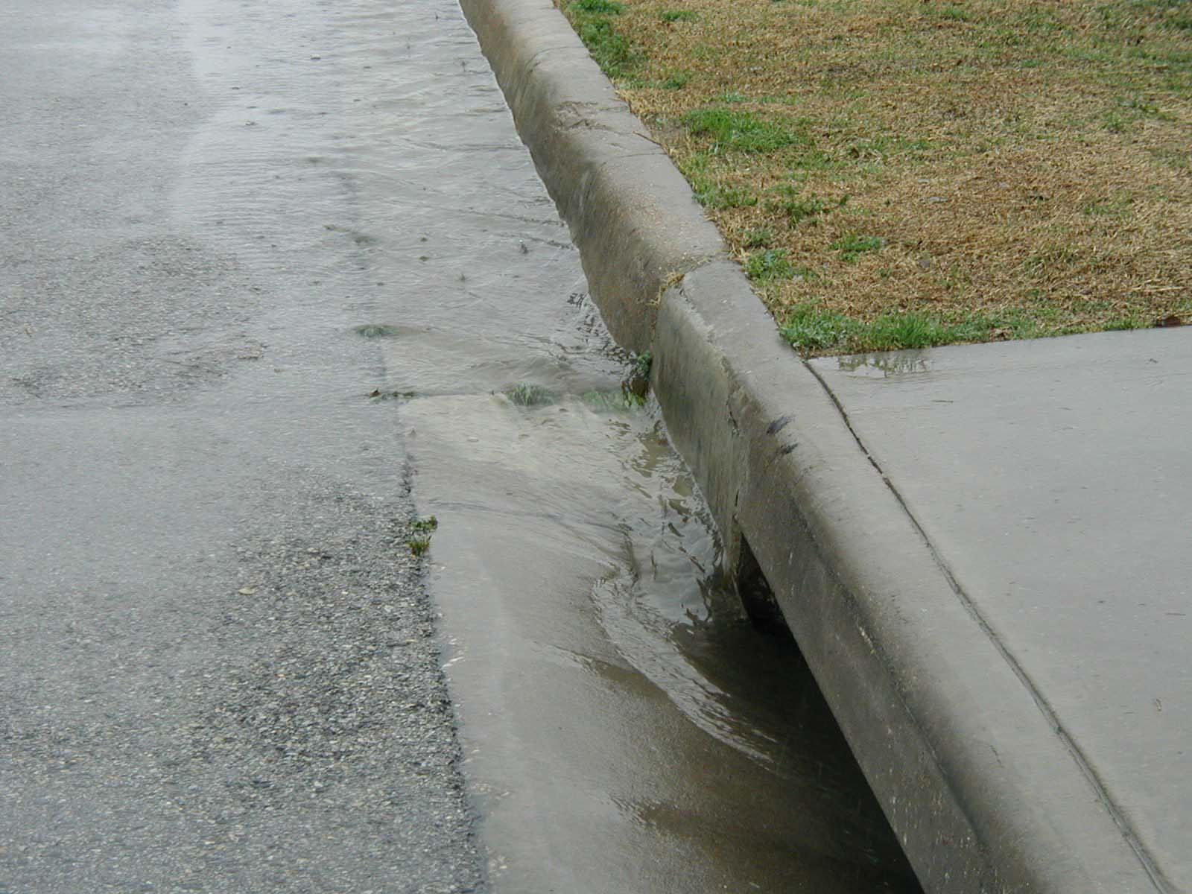
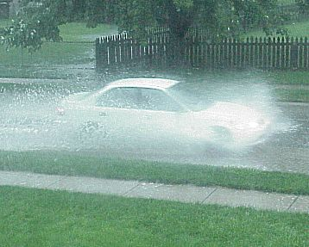
Storm Drainage System:
All surfaces, structures and systems that contribute to or convey stormwater runoff

Slide 23
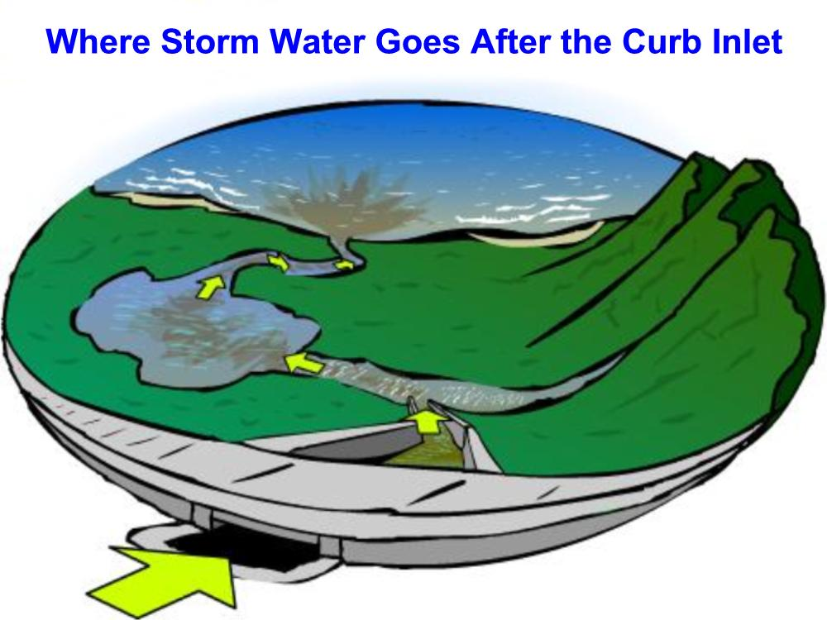

Slide 24
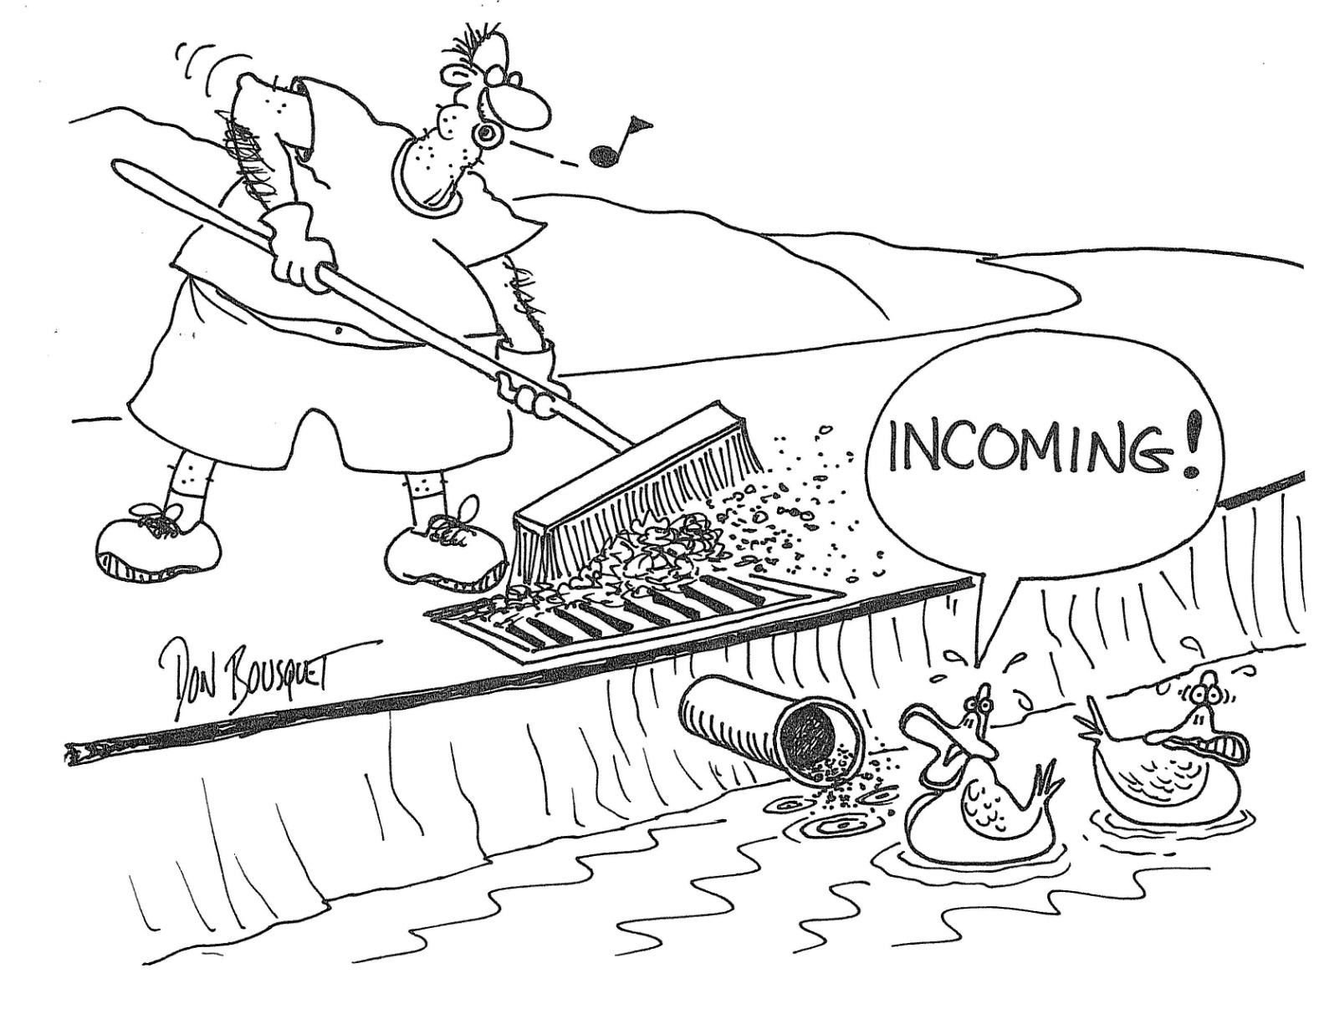

Slide 25

Pollutant: Any substance that contributes
to water pollution, including:
Rubbish, garbage, solid waste, litter, debris, yard waste, pesticides, herbicides, fertilizers, pet waste, animal waste, domestic sewage, industrial waste, mechanical fluid, oil, motor oil, grease, petroleum products, antifreeze, surfactants, solvents, detergents, cleaning agents, paint, heavy metals, toxins, household hazardous waste, small quantity generator waste, hazardous substances, hazardous waste, soil and sediment

Slide 26
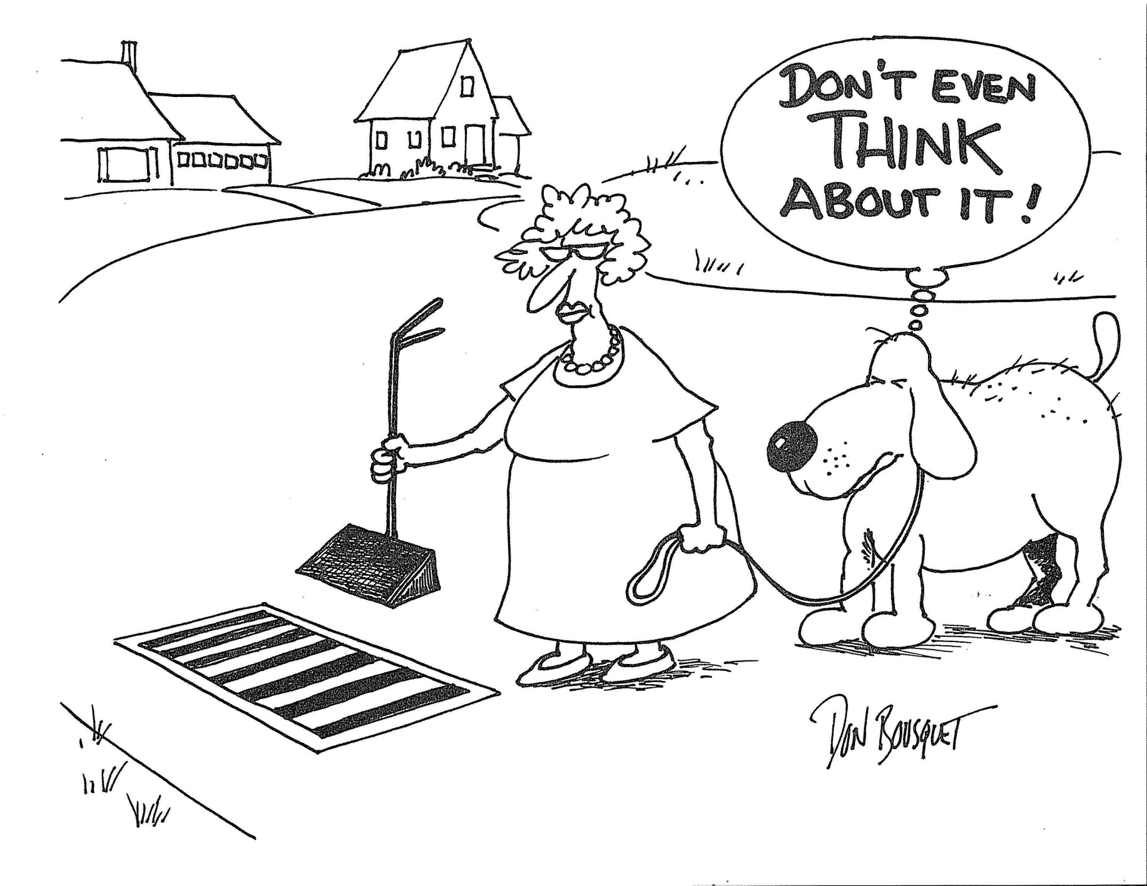

Slide 27
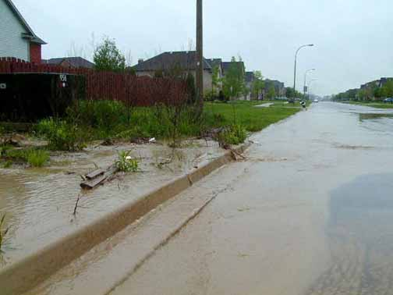

Stormwater Issues…
Developed and disturbed land contributes to problems in terms of:
Water quality
Water quantity
Other pollutants enter storm
sewers and pollute stormwater:
Illicit discharges
Illicit connections

